Slide 1

Cloud-Based Credit Risk Detection Using Machine Learning on Amazon-Sagemaker
Guided By,
Prof. Amjad Osama
Presented By,
Ayushkumar Patel (1269216)
Smit Patel (1263497)

Slide 2
Contents
Introduction
Project Overview & Objectives
Cloud Services and Tools Used
Dataset Description
Methodology & Workflow
Machine Learning Model Training
Cloud Deployment on AWS SageMaker
Frontend Implementation with Streamlit
Results and Evaluation
Conclusion
Future Work
References

Slide 3
Project Overview
What is this project about?
Development of a real-time credit risk assessment system using Machine Learning deployed on AWS SageMaker.
Predicts the likelihood of loan approval or rejection based on financial and demographic data.
Provides an interactive frontend using Streamlit connected to a cloud API endpoint.
Optimized for scalability and cost-effectiveness on AWS.
Demonstrates practical use of AI/ML in real-world finance applications

Slide 4
Project Objectives
Key Goals:
Build a scalable ML pipeline hosted entirely in the cloud.
Ensure low-latency predictions (<500 ms) for live banking systems.
Integrate multiple AWS services for model training, deployment, and monitoring.
Enable a user-friendly interface for end-users to submit loan applications and receive predictions instantly.

Slide 5
Cloud Services & Tools Used
AWS Infrastructure & Tools
AWS S3 – Data & model artifact storage.
AWS SageMaker – Model training, packaging, and endpoint hosting.
AWS IAM – Secure role-based access management.
AWS CloudWatch – Performance and latency monitoring.
AWS EC2 – Development & simulation environment.
AWS VPC – Network isolation and secure access.Streamlit – Frontend web interface.
Python (pandas, scikit-learn, boto3) – ML model development.

Slide 6
Dataset Overview
Data Description
Source: Processed Credit Risk Dataset.
Features: Age, Annual Income, Credit Score, Loan Amount, Employment Status, Debt-to-Income Ratio, Previous Defaults, etc.
Target Variable: Loan Approval Status (Approved / Rejected).

Slide 7
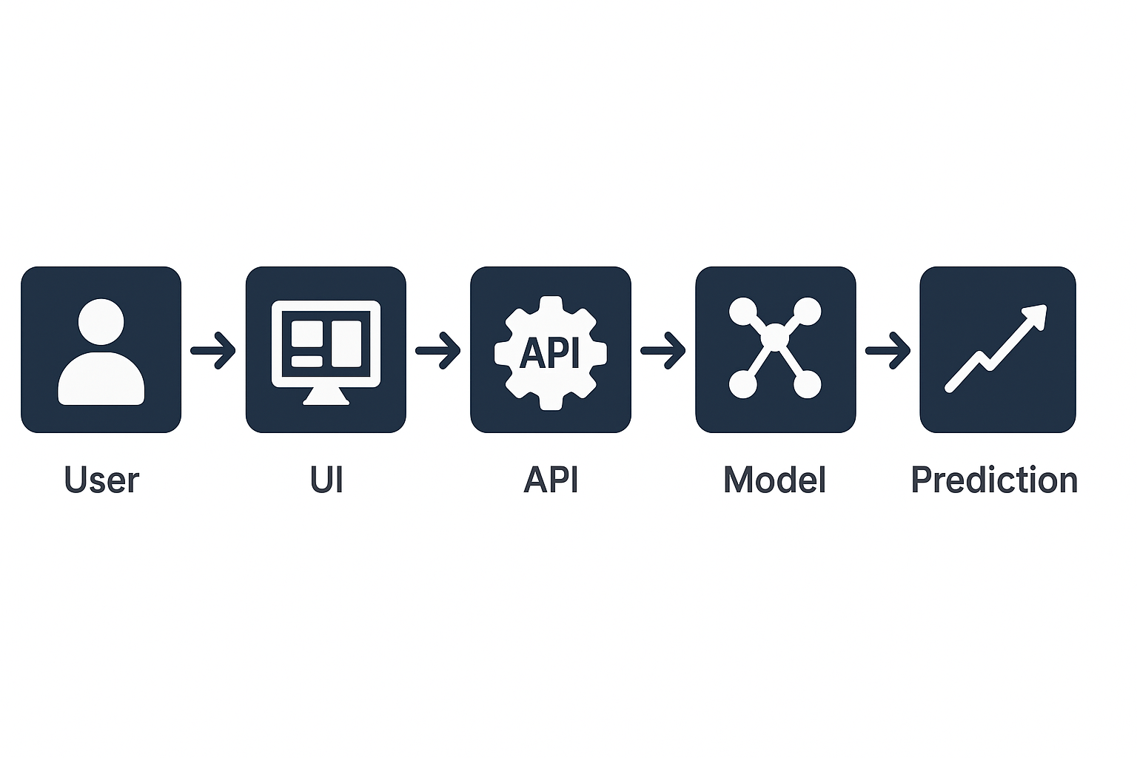
Methodology
End-to-End Workflow:
Data Preprocessing – Handle missing values, encode categorical features, normalize continuous variables.
Model Training – Random Forest Classifier tuned via grid search for optimal parameters.
Deployment – Model serialized, packaged, and uploaded to AWS S3. Endpoint deployed via AWS SageMaker.
Frontend Integration – Streamlit app makes POST requests to SageMaker endpoint for predictions.

Slide 8
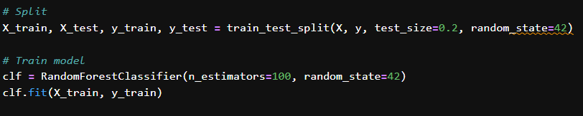
Model Training Machine Learning Details
Algorithm: Random Forest Classifier.
Hyperparameters: n_estimators=100, max_depth=10, min_samples_split=5.
Why Random Forest?
Handles mixed categorical & numerical features.
Reduces overfitting via averaging.
Interpretable feature importance.

Slide 9
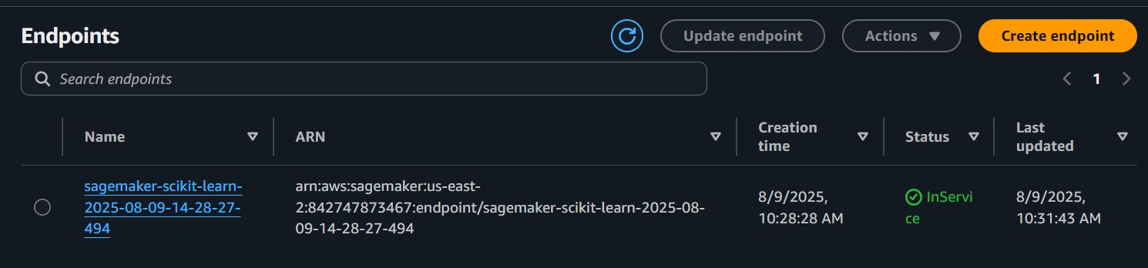
Cloud Deployment
AWS SageMaker Deployment:
Model packaged into .tar.gz and stored in S3.
SageMaker model object created using SKLearnModel.
Endpoint deployed for real-time inference.
CloudWatch monitoring for latency and uptime tracking.

Slide 10
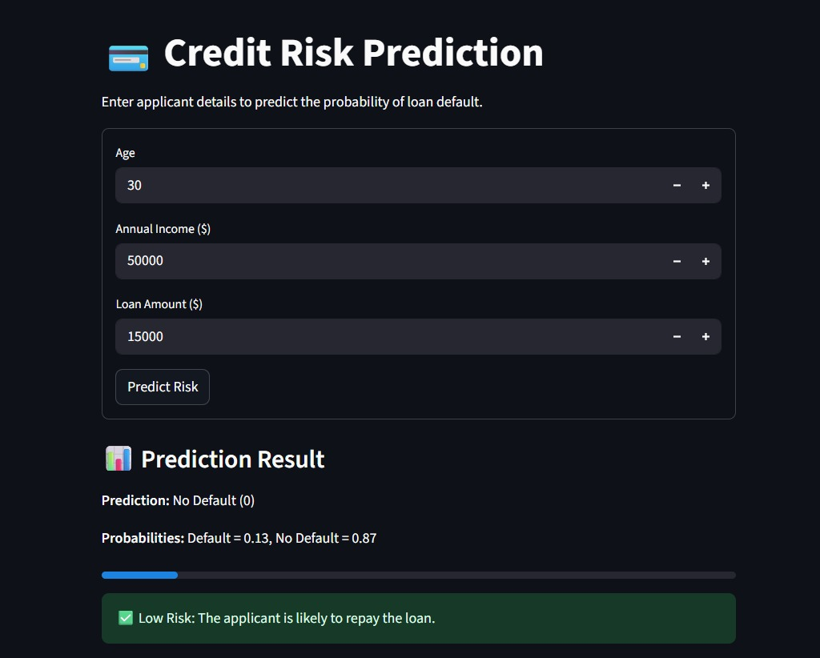
Frontend Implementation
Streamlit UIContent:
Inputs: Age, Income, Credit Score, Loan Amount, Employment Status, etc.Outputs:
Prediction: “Approved” or “Rejected”Probability score (e.g., 92% approval likelihood).
Connected to AWS endpoint via boto3 SDK.

Slide 11
Results & Evaluation
The model demonstrated high classification accuracy during validation, ensuring reliability in predicting credit risk categories.
Evaluation showed a balanced performance between precision and recall, indicating effective handling of both high-risk and low-risk cases.
Confusion matrix analysis confirmed that misclassification rates were minimal and within acceptable operational limits.
Cloud deployment testing verified low-latency responses, making the solution viable for real-time financial applications.

Slide 12
Conclusion & Future Work
Conclusion:
Delivered a highly accurate, low-latency ML model for credit risk prediction.
Successfully deployed on AWS SageMaker with secure and scalable architecture.
Integrated with a user-friendly Streamlit web application
Future Work:
Integrate XGBoost / LightGBM for improved accuracy.
Add Explainable AI (SHAP/LIME) to provide reasoning for predictions.
Expand dataset with additional borrower behavior metrics.
Enable multi-language support in the Streamlit UI for broader accessibility.

Slide 13


THANK YOU

